Slide 1

Unit-2 SDLC
Ideal Institute of Technology

Slide 2

What is Project
A project is defined as a “temporary endeavor with a beginning and an end and it must be used to create a unique product, service or result”.
Further, it is progressively elaborated. What this definition of a project means is that projects are those activities that cannot go on indefinitely and must have a defined purpose.

Slide 3
Project features
Sequence of tasks
Planned from beginning to end Bounded by time, resources, & required results
Defined outcome and "deliverables"
Deadline
Budget limits number of people, supplies, and capital

Slide 4
Tasks vs. Projects
Responding to email Making coffee Writing a letter to a prospect Hooking up a printer Producing a customer newsletter Catering a party Writing a book Implementing a computer network

Slide 5
What are the basic phases of a project and their purposes ?
The phases of a project make up the project life cycle.
For instance, a software project may have requirement, design, build, test, implementation phases whereas a project to build a metro or a building may have different names for each phase.
Notes:
The purpose of each phase of the project is a set of deliverables that are agreed upon before the project starts. For instance, in a software project, the requirement phase needs to generate the requirement documents, the design phase the design document etc. The build phase in a project delivers the completed code whereas the test phase is about the completed testing for the deliverables.
Each phase of the project is associated with a certain milestone and the set of deliverables that each phase is expected to deliver is then tracked for compliance and closure. The Project Life Cycle consists of the initiating, executing, controlling and closing processes of the framework as d

Slide 6
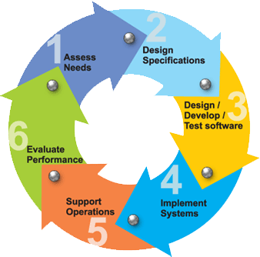

Slide 7
SDLC
The System Development Life Cycle, "SDLC" for short, is a multistep, iterative process, structured in a methodical way.
This process is used to model or provide a framework for technical and non-technical activities to deliver a quality system which meets or exceeds a business’s expectations or manage decision-making progression.

Slide 8
SDLC IN SUMMARY
Project Planning
Requirements Development
Design
Coding
Testing
Production Build/Deployment
Release
Maintenance

Slide 9
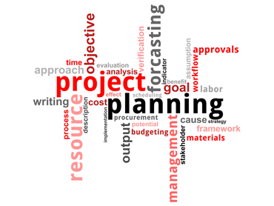
Project Planning
Prepare
Review
Rework
Baseline
Notes:
This is the first phase in the systems development process. It identifies whether or not there is the need for a new system to achieve a business"s strategic objectives. This is a preliminary plan (or a feasibility study) for a company"s business initiative to acquire the resources to build on an infrastructure to modify or improve a service. The company might be trying to meet or exceed expectations for their employees, customers and stakeholders too. The purpose of this step is to find out the scope of the problem and determine solutions. Resources, costs, time, benefits and other items should be considered at this stage.

Slide 10
Requirements Development
Develop
Review
Rework
Baseline
Revise
Notes:
the second phase is where businesses will work on the source of their problem or the need for a change. In the event of a problem, possible solutions are submitted and analyzed to identify the best fit for the ultimate goal(s) of the project. This is where teams consider the functional requirements of the project or solution. It is also where system analysis takes place—or analyzing the needs of the end users to ensure the new system can meet their expectations. Systems analysis is vital in determining what a business"s needs are, as well as how they can be met, who will be responsible for individual pieces of the project, and what sort of timeline should be expected.
There are several tools businesses can use that are specific to the second phase. They include:
Requirements gathering
Structured analysis

Slide 11
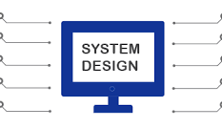
Systems Design
The third phase describes, in detail, the necessary specifications, features and operations that will satisfy the functional requirements of the proposed system which will be in place.
Notes:
This is the step for end users to discuss and determine their specific business information needs for the proposed system. It"s during this phase that they will consider the essential components (hardware and/or software) structure (networking capabilities), processing and procedures for the system to accomplish its objectives.

Slide 12

Coding
Code
Review
Rework
Commit
Recode

Slide 13
Integration and Testing
Test Plan/Test Cases/Scripts
Prepare
Review
Rework
Baseline
Revise [if necessary] >> Review >> Rework >> Baseline
Notes:
The fifth phase involves systems integration and system testing (of programs and procedures)—normally carried out by a Quality Assurance (QA) professional—to determine if the proposed design meets the initial set of business goals. Testing may be repeated, specifically to check for errors, bugs and interoperability. This testing will be performed until the end user finds it acceptable. Another part of this phase is verification and validation, both of which will help ensure the program"s successful completion.

Slide 14
Release
Prepare
Review
Rework
Release
Notes:
The seventh and final phase involves maintenance and regular required updates. This step is when end users can fine-tune the system, if they wish, to boost performance, add new capabilities or meet additional user requirements.

Slide 15
Maintenance
Recode [Enhance software / Fix bugs]
Retest
Redeploy
Rerelease
Notes:
The seventh and final phase involves maintenance and regular required updates. This step is when end users can fine-tune the system, if they wish, to boost performance, add new capabilities or meet additional user requirements.

